Slide 1

Predictive Analytics for Public Health in Cities
Felix Emeka Anyiam.
✓ http://orcid.org/0000-0003-2774-7406

Slide 2
The Power of Prediction in Urban Health
Predictive analytics represents a paradigm shift from reactive to proactive public health management. Cities generate vast amounts of health-related data daily—from emergency room visits and disease surveillance to environmental monitoring and social determinants indicators.
By analyzing patterns in this data, public health officials can forecast disease outbreaks, predict resource needs, and identify at-risk populations before crises emerge. This approach transforms traditional epidemiology into a forward-looking discipline that saves lives and optimizes limited public health resources.
From Reactive to Proactive
Resource Optimization
Equity-Focused Planning
Allocating staff, supplies, and funding where they'll have maximum impact
Identifying disparities and targeting interventions for vulnerable communities
Moving beyond crisis response to prevention and early intervention strategies

Slide 3

Disease Forecasting: Seeing Tomorrow's Health Threats
Disease forecasting uses historical infection patterns, environmental factors, and population mobility data to predict when and where outbreaks might occur. Cities track influenza-like illness reports, syndromic surveillance data, and even social media mentions to detect early warning signals.
Advanced models incorporate weather patterns, population density, vaccination rates, and seasonal behaviors. For vector-borne diseases like West Nile virus, predictive models analyze temperature, rainfall, and breeding site conditions to forecast mosquito populations and infection risk weeks in advance.

Slide 4



Hospital Resource Planning: Right Care, Right Time
Predictive models help hospitals anticipate patient volumes, staffing needs, and equipment requirements. These systems analyze admission patterns, seasonal trends, demographic shifts, and external factors like weather events or community health initiatives.
Bed Capacity Management
Staffing Optimization
Supply Chain Planning
Forecasting patient acuity and volume to ensure appropriate nurse-to-patient ratios and specialist coverage
Anticipating medication and equipment needs to prevent shortages and reduce waste from overstocking
Predicting census fluctuations to optimize bed availability and reduce boarding times in emergency departments

Slide 5

Outbreak Prediction: Early Warning Systems
Modern outbreak prediction combines traditional epidemiological surveillance with novel data sources. Cities monitor school absenteeism rates, pharmacy sales of over-the-counter medications, emergency department chief complaints, and even internet search trends to detect unusual patterns.
Key Indicators Monitored
Syndromic surveillance data
Laboratory test results
School and workplace absenteeism
Pharmacy sales patterns
Social media health mentions
Machine learning algorithms identify subtle signals that human analysts might miss, such as slight increases in respiratory complaints across multiple ZIP codes or unusual clustering of gastrointestinal symptoms near specific venues.
Environmental monitoring data

Slide 6
Case Study: COVID-19 Wave Predictions https://www.google.com/covid19/mobility/
During the pandemic, predictive models became critical tools for hospital preparedness. Seattle's health system developed models that integrated mobility data, testing positivity rates, and hospitalization trends to forecast COVID-19 surges with remarkable accuracy.
Data Integration
Policy Guidance
Combined epidemiological data with mobility patterns from cell phone data to track community transmission risk
Models informed reopening decisions and helped calibrate public health interventions to prevent system overload
1
2
3
Resource Allocation
Predicted ICU capacity needs 2-3 weeks in advance, enabling proactive staffing and equipment procurement

Slide 7

The Bias Problem: When Models Fail Communities
Predictive health models often perpetuate existing inequities when trained on biased or incomplete data. Low-income communities and communities of color are frequently underrepresented in health datasets, leading to models that work well for affluent areas but fail where they're needed most.
Common Sources of Bias
COMPAS (Criminal Justice)
Historical healthcare access disparities
The ProPublica investigation revealed that the algorithm disproportionately misclassified Black defendants—labeling them as high risk even when they did not reoffend, and conversely labeling white defendants as low risk more often when they did reoffend.
http://propublica.org/article/machine-bias-risk-assessments-in-criminal-sentencing
Incomplete socioeconomic data
Language barriers in health reporting
Mistrust of healthcare systems
Geographic data gaps in rural/urban fringe areas

Slide 8




Essential Tools for Health Predictions
Cities employ a diverse toolkit of technologies and methodologies to power their predictive analytics initiatives. These range from traditional statistical models to cutting-edge artificial intelligence systems.
Statistical Models
Machine Learning
Time series analysis, regression models, and epidemiological forecasting using tools like R and SAS for trend analysis and seasonal pattern detection
Neural networks, random forests, and ensemble methods that identify complex patterns in multi-dimensional health data using Python and TensorFlow
Data Integration Platforms
Visualization Tools
Cloud-based systems that combine electronic health records, environmental data, and social determinants using platforms like Palantir and custom APIs
Interactive dashboards and geographic information systems using Tableau, Power BI, and ArcGIS for real-time monitoring and decision support

Slide 9



Building the Future of Predictive Public Health
The next decade will see dramatic advances in urban health prediction capabilities. Success requires strategic investment in data infrastructure, workforce development, and community partnerships.
Community Engagement
Workforce Development
Infrastructure Investment
Build trust through transparent processes and ensure predictions serve all populations equitably
Train public health professionals in data science and create interdisciplinary teams combining domain expertise with technical skills
Develop integrated data systems and governance frameworks that enable responsible predictive analytics at scale

Slide 10

Student Worksheet: Applying Predictive Analytics in Urban Public Health
Instructions:
Access the dataset or tool provided in each section.
Explore the information for your chosen city or region.
Fill in the table with your findings, focusing on data trends, predictions, and public health implications.
Be prepared to discuss your insights with the class.

Slide 11
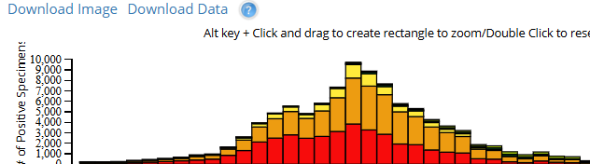
Disease Forecasting Tool: CDC FluView Interactive https://gis.cdc.gov/grasp/fluview/fluportaldashboard.html
Task: Examine influenza trends over the past 5 years.
Observation
1
Example: Peak in February each year
Forecast
2
Example: Higher incidence expected next Feb
Proposed Public Health Intervention
3
Example: Increase vaccination campaigns in December
Use the CDC FluView Interactive tool to analyze historical influenza patterns and make evidence-based predictions for upcoming seasons. Document your findings in the table above.

Slide 12

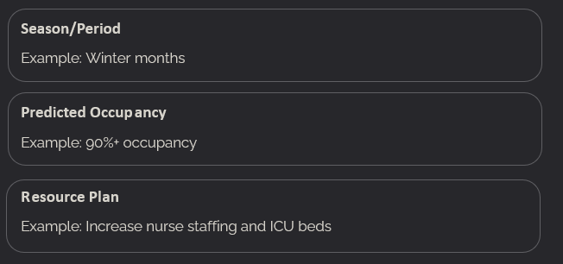

2. Hospital Resource Planning Dataset: NHS Bed Occupancy Data
https://www.england.nhs.uk/statistics/statistical-work-areas/bed-availability-and-occupancy/
Task: Identify seasonal bed occupancy trends and suggest staffing
or resource adjustments.
Analyze the NHS Bed Occupancy Data to identify patterns that can help hospitals prepare for periods of high demand. Consider how predictive analytics could improve resource allocation and patient care.

Slide 13

3. Outbreak Early-Warning Platform: HealthMap
https://www.healthmap.org/en/
Task: Select a current outbreak and analyze how predictive analytics could enhance early detection and response.
Outbreak
Data Sources Used
Example: Dengue in Southeast Asia
Example: News reports, official health alerts
Predictive Analytics Application
Example: Model mosquito population growth to predict future hotspots
Use the HealthMap platform to explore current disease outbreaks. Consider how combining multiple data sources with predictive analytics could improve early warning systems and public health responses.

Slide 14


